Slide 1
Group 5
Makenzie Barber, Sunjay Hawkins, Mike Dyrhaug, and Isaiah Galvan

Slide 2
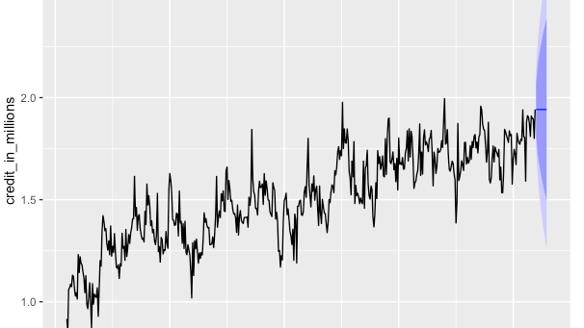

Naive Model
The Naive method of forecasting allows us to use the previous years data in order to predict the next year of data.
The RMSE (root mean squared error) for the forecast of this model was about .43 standard deviations from the actual mean of our credit data.
The MAPE (mean absolute percentage error) for this forecast was about 41% of a difference between the credit forecasted and the actual credit values observed.

Slide 3
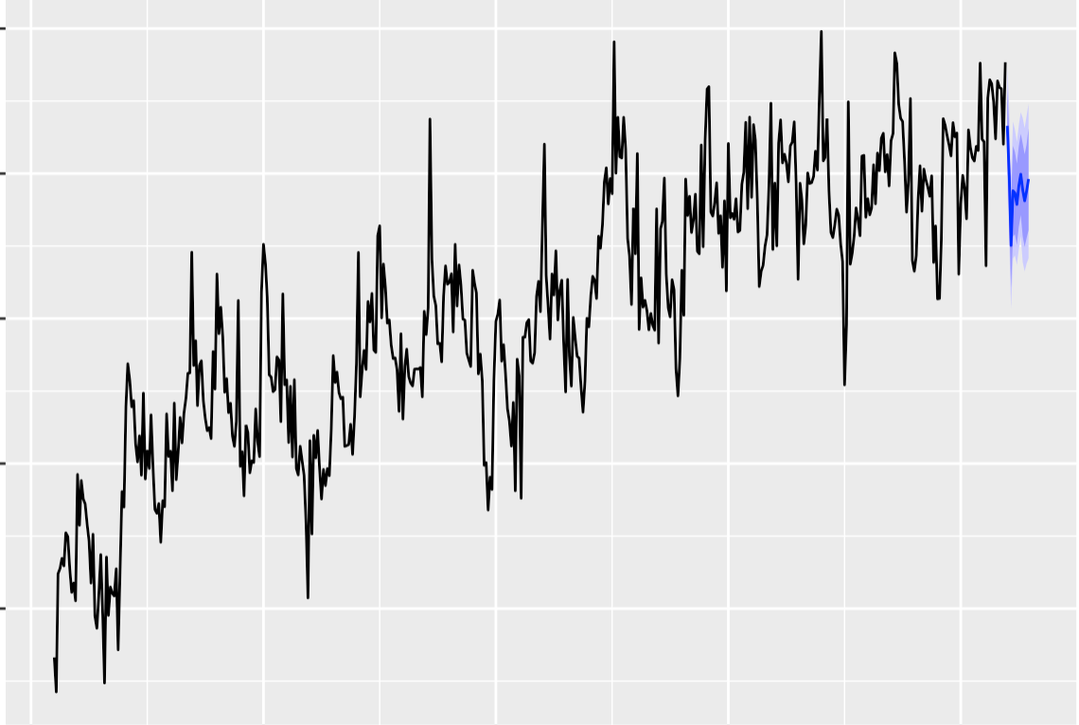
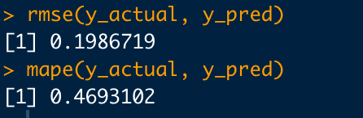
Neural Net Model
The neural net is a model that makes predictions using models similar to the way our brain thinks.
This model had a low RMSE (measure of error) on the forecast of about .29 standard deviations from the mean of the overall data.
The MAPE (another measure of error) for this forecast was .46 of a difference between the credit forecasted and the actual credit values observed.

Slide 4
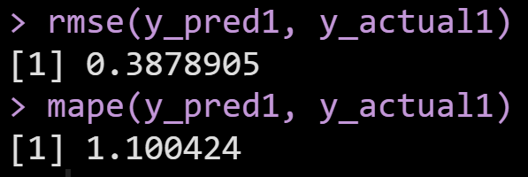
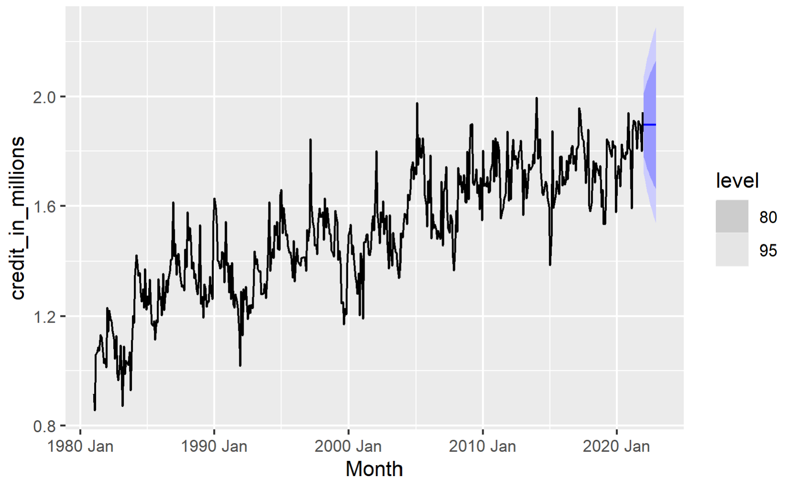
ARIMA Model
The ARIMA model is a auto-regression model that uses lags
It does not matter when the point was observed in the dataframe
The RMSE (root mean squared error) for the forecast of this model was about .388 standard deviations from the actual mean of our credit data.
The MAPE (mean absolute percentage error) for this forecast was 1.1 difference between the credit forecasted and the actual credit values observed.

Slide 5
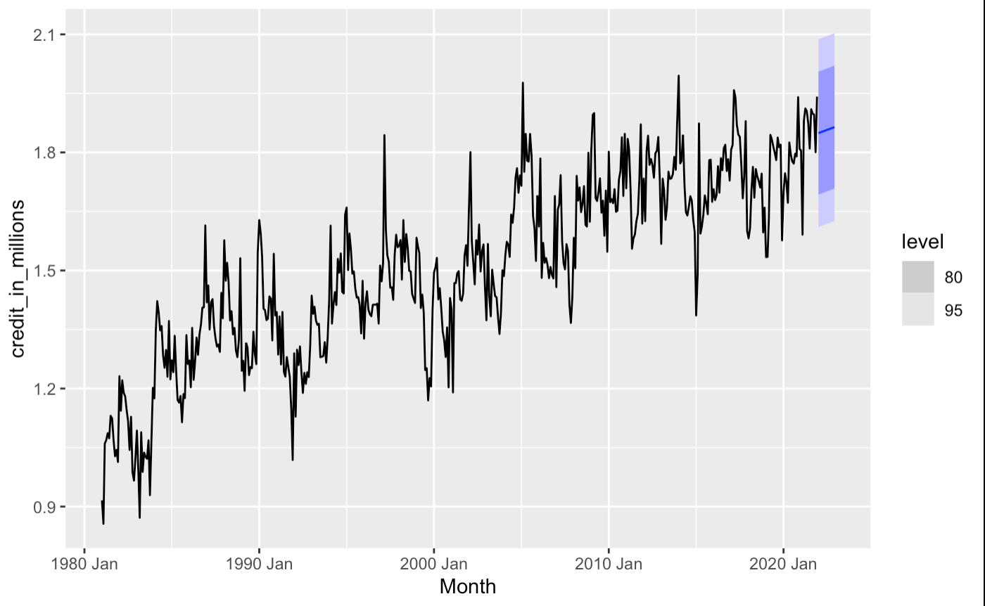
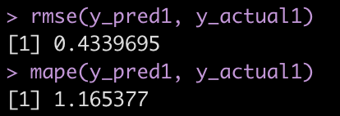
TSLM Model
A Time Series Linear Model is a regression model that allows for a linear relationship between the forecast variable (y) and predictor variable (x)
The RMSE (root mean squared error) for the forecast of this model is approximately .434 standard deviations away from the actual mean of the credit data.
The MAPE (another measure of error) for this forecast was a difference of 1.17 between the credit forecasted and the actual credit observed.

Slide 6
The best model: NNet
This model had a low RMSE (measure of error) on the forecast of about .19 standard deviations from the mean of the overall data. This was the lowest RMSE, which was closest to the mean of all the models.
The MAPE (another measure of error) for this forecast was .46 of a difference between the credit forecasted and the actual credit values observed. This was the closest MAPE that we could gather.

